Slide 1


Voting System
New
Facility
June
2020

Slide 2

Objective
Apply a design technique to find out which facility is the winner given all the votes, or decide that no new facility is being built

Slide 3
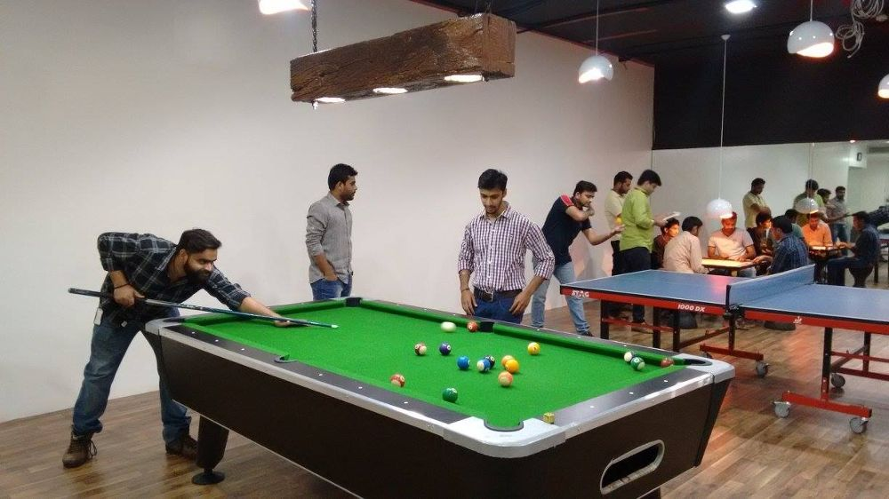

Different facilities
A company can incorporate different facilities to help itself and its employees
The different facilities are like indoor and outdoor games, massage chairs, fully-equipped gyms, health facilities etc.
But different people can have different requirement.
And the company will like to install a facility which suits the necessity of most of the people.
Considering this case it requires a voting system, which we will make this project.

Slide 4

Let’s start
Now we need to incorporate an appropriate method to make such a system
In the following slides we will see how we can perform some steps to get the final system we want.

Slide 5
Option of facilities
Algorithm for accepting the facilities
First we need to know the facilities available for the voting process.
So we need to accept that first.
Step 1 : Accept number of Facility as facilityNumber
Step 2 : i=0
Step 3 : if i<facilityNumber then go to step 4 otherwise end
Step 4 : Accept facility[i]
Step 5 : i= i+1 go to step 3
Step 6 : end

Slide 6
Voters & Vote
Algorithm for accepting the votes
Now we need to know the number of voters.
And then to which facility will there vote will go.
Step 1 : Accept Number of Voters as votersNumber
Step 2 : n = votersNumber
Step 3 : if n>0 then go to step 4 otherwise step 7
Step 4 : Accept current vote in currVote
Step 5 : vote[currVote-1] = vote[currVote-1] + 1
Step 6 : n = n-1 go to step 3
Step 7 : end

Slide 7
Evaluate the Winning Facility
Algorithm for accepting the votes
After getting all the votes now we just have to count the number of votes for each facility and get to know if there is a winning facility.
But considering what we have done yet , do we really have to count the votes for each facility.
Let us check this out in the following algorithm for the same.
Step 1 : index=-1 , i=0
Step 2 : if i<facilityNumber go to step 3 else go to step 5
Step 3 : if vote[i] > votersNumber/2 then index = i
Step 4 : i = i + 1 go to 2
Step 5 : if index = -1 then
print “No Winning facility”
otherwise
print facility[index] as “Winning Facility”
Step 6 : end

Slide 8
Final code
#include<stdio.h>
#include<stdlib.h>
#include<string.h>
struct facility
{ char f[50];
};
void takeInput(int *facilityNumber, int *votersNumber)
{
int i;
printf("Enter Number of Facility: ");
scanf("%d", facilityNumber);
printf("\nEnter Number of Voters: ");
scanf("%d", votersNumber);
}
void printingFacilities(struct facility *fac, int facilityNumber)
{
int i;
printf("\nFacilities Listed for Voting: \n");
for(i=0 ;i<facilityNumber ;i++)
{
printf("%d.",(i+1));
puts(fac[i].f);
}
printf("\n");
}

Slide 9
void takingVotes(int *vote, int facilityNumber, int votersNumber)
{
int num, n=9, currVote;
printf("\nVote Your Facility\n");
num = 1;
n = votersNumber;
while(n--)
{
printf("Voter %3d : ", num++);
scanf("%d", &currVote);
if(0 < currVote < facilityNumber)
vote[currVote-1]++;
}
printf("\n");
}
void calculatingResult(struct facility *fac, int *vote, int votersNumber, int facilityNumber)
{
int index=-1,i;
for(i=0; i<facilityNumber; i++)
{
printf("\nVote for ");
printf("%s", fac[i].f);
printf(" is : %3d", vote[i]);
if(vote[i]>(votersNumber/2))
index=i;
}
printf("\n");
if(index==-1)
printf("\nNo Winning facility \n");
else
printf("\nWinning Facility is :: %s \n", fac[index].f);
}

Slide 10
int main()
{
int votersNumber, facilityNumber, n, buffer, i, *vote;
struct facility *fac;
takeInput(&facilityNumber, &votersNumber);
fac = (struct facility *)malloc(facilityNumber * sizeof(struct facility));
vote = (int *)malloc(facilityNumber * sizeof(int));
scanf("%c", &buffer);
printf("\nEnter Facilities: \n");
for(i=0; i<facilityNumber; i++)
{ gets(fac[i].f);
vote[i] = 0;
}
printingFacilities(fac, facilityNumber);
takingVotes(vote, facilityNumber, votersNumber);
calculatingResult(fac, vote, votersNumber, facilityNumber);
return 0;
}

Slide 11

Time complexity
O(n)
For accepting the number of facilities and the number of voters, the complexity will be O(n).
As hashing is used during the accepting time, we get the maximum number of votes by checking the votes got in for all the facilities , which will again be O(n).
If hashing wasn’t being used , the complexity would be O(n X e)
Therefore , the final time complexity is…

Slide 12
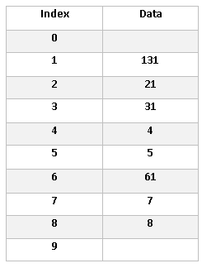
Approach Used
When a voter is voting for a particular facility , we are going to that particular facility and increasing then vote in that facility.
Because of this , we don’t need to count the number of votes for each facility lately.
Next we can just find out the maximum vote received by a facility.
Therefore, approach used is…
Hashing

Slide 13
Possible voting
This is a possible bar graph for, for a valid voting process. Here we can see that indoor votes is the winner with 60% of the votes.

Slide 14

Conclusion
This type of system is very common and useful.
This can be used not only is company to install a new facility , but also in a country to elect a party , and see who is the winning party.

Slide 15

THANK YOU!
Presented by:
Shilpa Agarwal
Rupnarayan Kumar
Sumit Anand
Sonam Raja

